Slide 1
Artificial Neural networks
Dinabandhu Bhandari

Slide 2
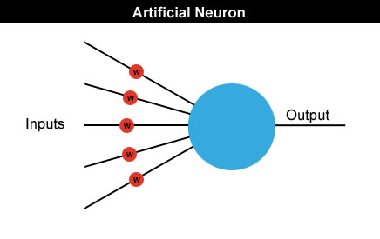
Neural networks
Neural networks are made up of many artificial neurons.
Each input into the neuron has its own weight associated with it illustrated by the red circle.
A weight is simply a floating point number and are adjusted/ tuned during the training of the network.

Slide 3
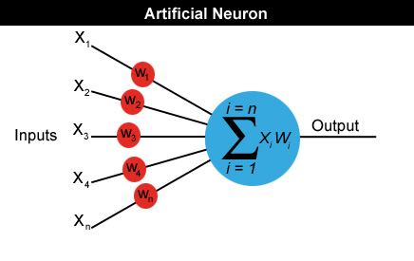
Neural networks
A neuron can have any number of inputs from one to n, where n is the total number of inputs.
The inputs may be represented therefore as x1, x2, x3… xn.
And the corresponding weights for the inputs as w1, w2, w3… wn.
Output a = x1w1+x2w2+x3w3... +xnwn

Slide 4
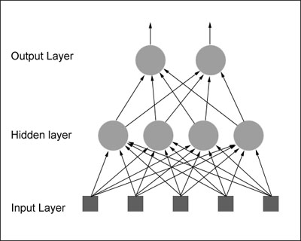
How do we actually use an artificial neuron?
Feedforward network: The neurons in each layer feed their output forward to the next layer until we get the final output from the neural network.
There can be any number of hidden layers within a Feedforward network.
The number of neurons can be completely arbitrary.

Slide 5
Multi-Layer Perceptron (MLP)

Slide 6
x₁
x_{n}
We will introduce the MLP and the backpropagation algorithm which is used to train it
MLP used to describe any general feedforward (no recurrent connections) network
However, we will concentrate on nets with units arranged in layers

Slide 7
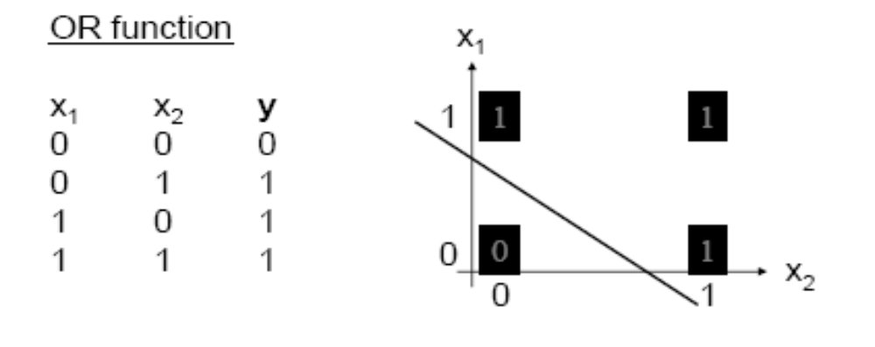
Perceptron Learning Theorem
Recap: A perceptron (threshold unit) can learn anything that it can represent (i.e. anything separable with a hyperplane)

Slide 8
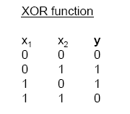
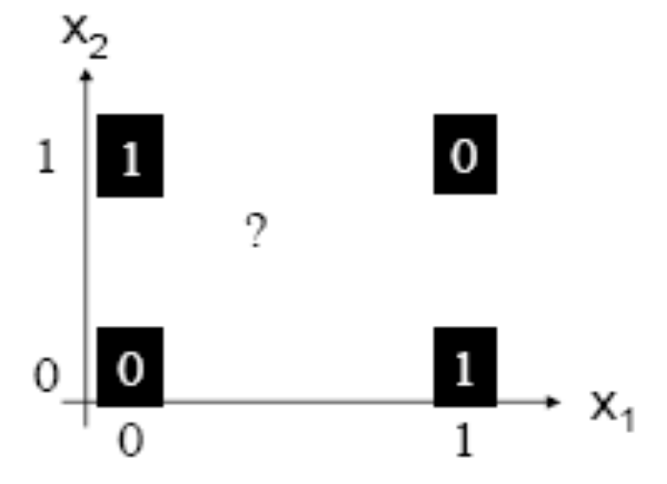
The Exclusive OR problem
A Perceptron cannot represent Exclusive OR since it is not linearly separable.

Slide 9
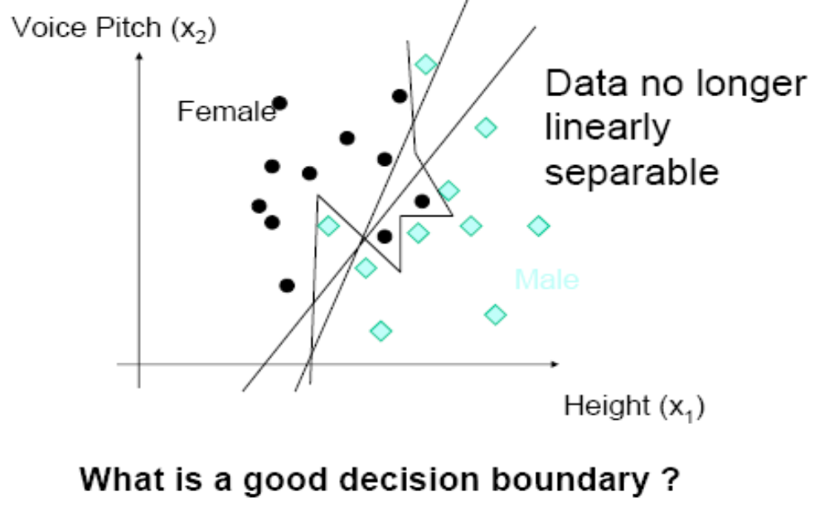

Slide 10
Minsky & Papert (1969) offered solution to XOR problem by
combining perceptron unit responses using a second layer of
Units. Piecewise linear classification using an MLP with
threshold (perceptron) units
+1
1
3
2
+1

Slide 11
Three-layer networks
x₁
x₂
Input
Output
x_{n}
Hidden layers

Slide 12
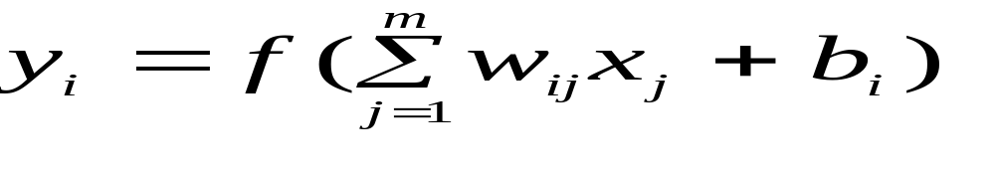
Properties of architecture
No connections within a layer
No direct connections between input and output layers
Fully connected between layers
Number of output units need not equal number of input units
Number of hidden units per layer can be more or less than
input or output units
Often include bias as an extra weight

Slide 13
What do each of the layers do?
3rd layer can generate arbitrarily complex boundaries
1st layer draws linear boundaries
2nd layer combines the boundaries

Slide 14
Backpropagation learning algorithm ‘BP’
BP has two phases:
Forward pass phase: computes ‘functional signal’, feed forward
propagation of input pattern signals through network
Backward pass phase: computes ‘error signal’, propagates
the error backwards through network starting at output units
(where the error is the difference between actual and desired
output values)

Slide 15
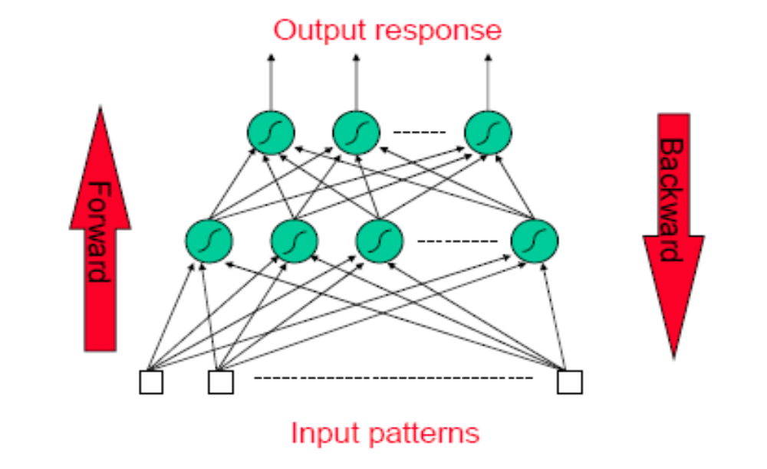
Conceptually: Forward Activity -
Backward Error

Slide 16
Training ANNs
Training set S of examples {x,t}
  x is an input vector and
  t the desired target vector
  Example: Logical And
  S = {(0,0),0}, {(0,1),0}, {(1,0),0}, {(1,1),1}
Iterative process
  Present a training example x , compute network output y , compare output y with target t, adjust weights and thresholds
Learning rule
  Specifies how to change the weights w and thresholds θ of the network as a function of the inputs x, output y and target t.

Slide 17
Linear Unit
inputs
weights
x₁
w₁
output
w₂
activation
x₂
Σ
y
.
.
.
y= a = Σ_{i=1}^{n} w_{i} x_{i}
a=Σ_{i=1}^{n} w_{i} x_{i}
w_{n}
x_{n}

Slide 18
Gradient Descent Learning Rule
Consider linear unit without threshold and continuous output o (not just –1,1)
  o=w₀ + w₁ x₁ + … + w_{n} x_{n}
Train the w_{i}’s such that they minimize the squared error
  E[w₁,…,w_{n}] = ½ Σ_{d∈D} (t_{d}-o_{d})²
  where D is the set of training examples

Slide 19
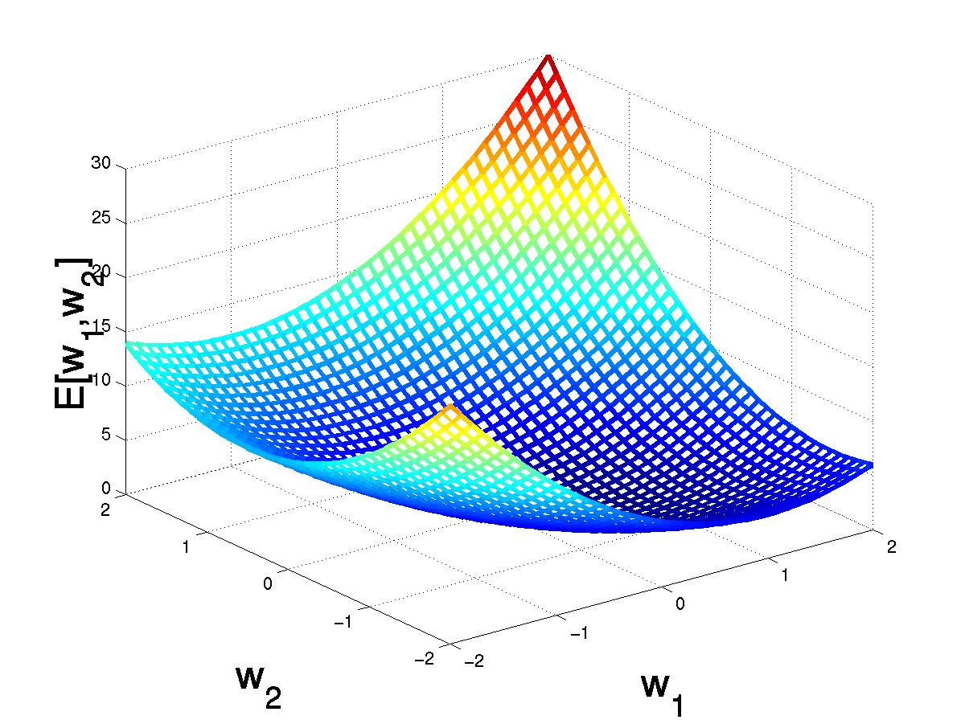
Gradient Descent
D={<(1,1),1>,<(-1,-1),1>,
<(1,-1),-1>,<(-1,1),-1>}
(w₁,w₂)
Gradient:
∇E[w]=[∂E/∂w₀,… ∂E/∂w_{n}]
Δw=-η ∇E[w]
(w₁+Δw₁,w₂ +Δw₂)
Δw_{i}=-η ∂E/∂w_{i}
=∂/∂w_{i} 1/2Σ_{d}(t_{d}-o_{d})²
= ∂/∂w_{i} 1/2Σ_{d}(t_{d}-Σ_{i} w_{i} x_{i})²
= Σ_{d}(t_{d}- o_{d})(-x_{i})

Slide 20
Incremental Stochastic Gradient Descent
Batch mode : gradient descent
w=w - η ∇E_{D}[w] over the entire data D
E_{D}[w]=1/2Σ_{d}(t_{d}-o_{d})²
Incremental mode: gradient descent
w=w - η ∇E_{d}[w] over individual training examples d
E_{d}[w]=1/2 (t_{d}-o_{d})²
Incremental Gradient Descent can approximate Batch Gradient Descent arbitrarily closely if η is small enough

Slide 21
Neuron with Sigmoid-Function
inputs
weights
x₁
w₁
output
w₂
activation
x₂
Σ
y
.
.
.
a=Σ_{i=1}^{n} w_{i} x_{i}
w_{n}
x_{n}
y=σ(a) =1/(1+e^{-a})

Slide 22
Sigmoid Unit
x₀₌-1
x₁
w₁
w₀
a=Σ_{i=0}^{n} w_{i} x_{i}
y=σ(a)=1/(1+e^{-a})
w₂
x₂
Σ
y
.
.
.
w_{n}
σ(x) is the sigmoid function: 1/(1+e^{-x})
dσ(x)/dx= σ(x) (1- σ(x))
x_{n}
Derive gradient decent rules to train:
one sigmoid function
∂E/∂w_{i} = -Σ_{p}(t^{p}-y) y (1-y) x_{i}^{p}
Multilayer networks of sigmoid units
backpropagation:

Slide 23
Gradient Descent Rule for Sigmoid Output Function
σ
sigmoid
  E^{p}[w₁,…,w_{n}] = ½ (t^{p}-y^{p})²
∂E^{p}/∂w_{i} = ∂/∂w_{i} ½ (t^{p}-y^{p})²
= ∂/∂w_{i} ½ (t^{p}- σ(Σ_{i} w_{i} x_{i}^{p}))²
= (t^{p}-y^{p}) σ‘(Σ_{i} w_{i} x_{i}^{p}) (-x_{i}^{p})
for y=σ(a) = 1/(1+e^{-a})
σ’(a)= e^{-a}/(1+e^{-a})²=σ(a) (1-σ(a))
a
σ’
a
w’_{i}= w_{i} + Δw_{i} = w_{i} + α y(1-y)(t^{p}-y^{p}) x_{i}^{p}

Slide 24
Gradient Descent Learning Rule
y_{j}
w_{ji}
x_{i}
Δw_{i} = α y_{j}^{p}(1-y_{j}^{p}) (t_{j}^{p}-y_{j}^{p}) x_{i}^{p}
activation of
pre-synaptic neuron
learning rate
derivative of
activation function
error δ_{j} of
post-synaptic neuron

Slide 25
Learning with hidden units
Networks without hidden units are very limited in the input-output mappings they can model.
  More layers of linear units do not help. Its still linear.
  Fixed output non-linearities are not enough
We need multiple layers of adaptive non-linear hidden units. This gives us a universal approximator. But how can we train such nets?
  We need an efficient way of adapting all the weights, not just the last layer. This is hard. Learning the weights going into hidden units is equivalent to learning features.
  Nobody is telling us directly what hidden units should do.

Slide 26
The idea behind backpropagation
We don’t know what the hidden units ought to do, but we can compute how fast the error changes as we change a hidden activity.
  Instead of using desired activities to train the hidden units, use error derivatives w.r.t. hidden activities.
  Each hidden activity can affect many output units and can therefore have many separate effects on the error. These effects must be combined.
  We can compute error derivatives for all the hidden units efficiently.
  Once we have the error derivatives for the hidden activities, its easy to get the error derivatives for the weights going into a hidden unit.

Slide 27
Multi-Layer Networks
output layer
hidden layer
input layer

Slide 28
Training-Rule for Weights to the Output Layer
E^{p}[w_{ij}] = ½ Σ_{j} (t_{j}^{p}-y_{j}^{p})²
y_{j}
∂E^{p}/∂w_{ji} = ∂/∂w_{ji} ½ Σ_{j} (t_{j}^{p}-y_{j}^{p})²
= …
= - y_{j}^{p}(1-y^{p}_{j})(t^{p}_{j}-y^{p}_{j}) x_{i}^{p}
w_{ji}
x_{i}
Δw_{ji} = α y_{j}^{p}(1-y_{j}^{p}) (t^{p}_{j}-y_{j}^{p}) x_{i}^{p}
= α δ_{j}^{p} x_{i}^{p}
with δ_{j}^{p} := y_{j}^{p}(1-y_{j}^{p}) (t^{p}_{j}-y_{j}^{p})

Slide 29
Training-Rule for Weights to the Hidden Layer
δ_{j}
y_{j}
Credit assignment problem:
No target values t for hidden layer
units.
w_{jk}
x_{k}
δ_{k}
Error for hidden units?
δ_{k} = Σ_{j} w_{jk} δ_{j} y_{j} (1-y_{j})
w_{ki}
Δw_{ki} = α x_{k}^{p}(1-x_{k}^{p}) δ_{k}^{p} x_{i}^{p}
x_{i}

Slide 30
Training-Rule for Weights to the Hidden Layer
δ_{j}
y_{j}
E^{p}[w_{ki}] = ½ Σ_{j} (t_{j}^{p}-y_{j}^{p})²
w_{jk}
∂E^{p}/∂w_{ki} = ∂/∂w_{ki} ½ Σ_{j} (t_{j}^{p}-y_{j}^{p})²
=∂/∂w_{ki} ½Σ_{j} (t_{j}^{p}-σ(Σ_{k}w_{jk} x_{k}^{p}))²
=∂/∂w_{ki} ½Σ_{j} (t_{j}^{p}-σ(Σ_{k}w_{jk} σ(Σ_{i}w_{ki} x_{i}^{p})))²
= -Σ_{j} (t_{j}^{p}-y_{j}^{p}) σ’_{j}(a) w_{jk} σ’_{k}(a) x_{i}^{p}
= -Σ_{j} δ_{j} w_{jk} σ’_{k}(a) x_{i}^{p}
= -Σ_{j} δ_{j} w_{jk} x_{k} (1-x_{k}) x_{i}^{p}
x_{k}
δ_{k}
w_{ki}
x_{i}
Δw_{ki} = α δ_{k} x_{i}^{p}
with δ_{k} = Σ_{j} δ_{j} w_{jk} x_{k}(1-x_{k})

Slide 31
Backpropagation
y_{j}
Backward step:
propagate errors from output to hidden layer
δ_{j}
w_{jk}
x_{k}
δ_{k}
w_{ki}
Forward step:
Propagate activation
from input to output layer
x_{i}

Slide 32
Backpropagation Algorithm
Initialize each w_{i} to some small random value
Until the termination condition is met, Do
  For each training example <(x₁,…x_{n}),t> Do
    Input the instance (x₁,…,x_{n}) to the network and compute the network outputs y_{k}
    For each output unit k
      δ_{k}=y_{k}(1-y_{k})(t_{k}-y_{k})
    For each hidden unit h
      δ_{h}=y_{h}(1-y_{h}) Σ_{k} w_{h,k} δ_{k}
    For each network weight w_{i,j} Do
    w_{i,j}=w_{i,j}+Δw_{i,j} where
      Δw_{i,j}= η δ_{j} x_{i,j}

Slide 33
Backpropagation
Gradient descent over entire network weight vector
Easily generalized to arbitrary directed graphs
Will find a local, not necessarily global error minimum
-in practice often works well (can be invoked multiple times with different initial weights)
Often include weight momentum term
      Δw_{i,j}(n)= η δ_{j} x_{i,j} + α Δw_{i,j} (n-1)
Minimizes error training examples
  Will it generalize well to unseen instances (over-fitting)?
Training can be slow typical 1000-10000 iterations
(use Levenberg-Marquardt instead of gradient descent)
Using network after training is fast

Slide 34
Convergence of Backprop
Gradient descent to some local minimum perhaps not global minimum
Add momentum term: Δw_{ki}(n)
  Δw_{ki}(n) = α δ_{k}(n) x_{i} (n) + λ Δw_{ki}(n-1)
      with λ ∈ [0,1]
Stochastic gradient descent
Train multiple nets with different initial weights
Nature of convergence
Initialize weights near zero
Therefore, initial networks near-linear
Increasingly non-linear functions possible as training progresses

Slide 35
Ways to use weight derivatives
How often to update
  after each training case?
  after a full sweep through the training data?
How much to update
  Use a fixed learning rate?
  Adapt the learning rate?
  Add momentum?
  Don’t use steepest descent?

Slide 36
Training
This was a single iteration of back-prop
Training requires many iterations with many training examples or epochs (one epoch is entire presentation of complete training set)
It can be slow !
Note that computation in MLP is local (with respect to each neuron)
Parallel computation implementation is also possible

Slide 37
Training and testing data
How many examples ?
  The more the merrier !
Disjoint training and testing data sets
  learn from training data but evaluate performance (generalization ability) on unseen test data
Aim: minimize error on test data

Slide 38
Applications of neural networks
Paragraph Classification
Effort estimation for copy editing
Daily Shotcrete Roadway Development – An Estimation Model

